Slide 1

Testing Statistical Hypothesis
Chapter 7 Part 4
Dr. Abolfazl Saghafi
Assistant Professor of Statistics & Data Science
Data Science Program Director
Notes:
Testing for p

Slide 2
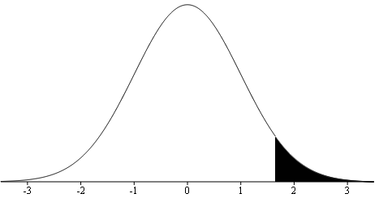


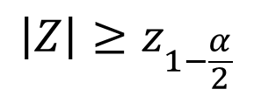

Testing population Proportion (p)
α% testing of p
unknown
1. Find out the significance level α, use α = 0.05 if not given
2. Write down the null (H₀: p = p₀) and alternate (either
H₁: p ≠ p₀, H₁: p > p₀, or H₁: p < p₀) hypothesis
Normal Distribution
3. The test statistics is $Z=\frac{\hat{p}−p_{0}}{\sqrt{p_{0}\left(1−p_{0}\right)/n}}$ compute its value
4. Determine the rejection region considering the alternate
Critical Value:
= Invnorm(1-α/2)
$$z_{1−α/2}$$
$$\left|Z\right|≥z_{1−\frac{α}{2}}$$
$$Z≥z_{1−α}$$
$$Z≤{−z}_{1−α}$$
5. Reject H₀ if the computed value of $Z$ is in the rejection region, fail to reject otherwise
6. Make an inference statement relating the decision to the problem

Slide 3





Ex1. National Crime Rates
According to the FBI and the Justice Department, 70% of all arrests are males aged 15 to 34 years. A random sample showed that out of 32 arrest, 24 were of males aged 15 to 34 years.
Use a 1% level of significance to test the claim that the proportion of such arrests is different from 70%.
X: Number of arrested people who are 15-34 yo ~ Bin(n, p = ?)
$$n=32$$
$$x=24$$
$$\hat{p}=24/34=0.75$$
Claim: 70% of all arrests are males 15-34 yo
$$p_{0}=0.70$$
Alternative: claim is wrong

Slide 4
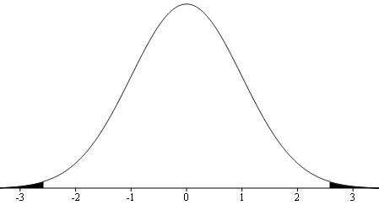

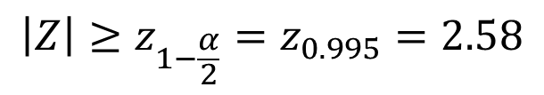
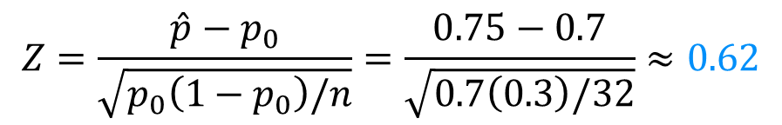
1. α = 0.01
2. H₀: p = 0.70 Vs H₁: p ≠ 0.70
3. Test Statistic:
$$Z=\frac{\hat{p}−p_{0}}{\sqrt{p_{0}\left(1−p_{0}\right)/n}}=\frac{0.75−0.7}{\sqrt{0.7\left(0.3\right)/32}}≈0.62$$
4.
Rejection Region:
$$\left|Z\right|≥z_{1−\frac{α}{2}}=z_{0.995}=2.58$$
Rejection Region
5. z = 0.62 is NOT in the rejection region, H₀ is NOT rejected
6. At 1% level of significance the there is insufficient evidence to reject the null hypothesis and the FBI statement is statistically correct, 70% of all arrests are male 15-34 yo
7.
P-value = $P\left(Z≤−0.62\right)+P\left(Z≥0.62\right)=2∗normalcdf\left(−99,−0.62\right)=0.5354$

Slide 5

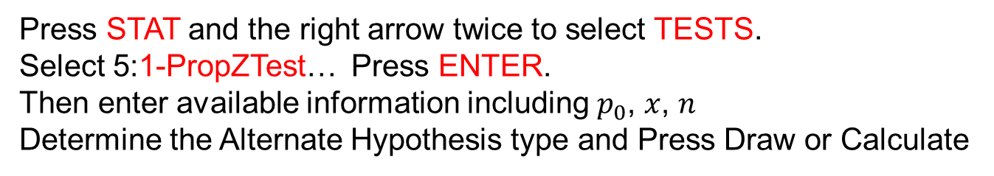
Ex2. Gender Selection
Among 100 babies born to 100 couples using a gender-selection method to increase the likelihood of a baby girl, 65 of them are girls.
Use a 0.05 significance level to test the claim that for couples using this method, the proportion of girls is greater than 0.5.
Press STAT and the right arrow twice to select TESTS.
Select 5:1-PropZTest… Press ENTER.
Then enter available information including $p_{0}$, $x$, $n$
Determine the Alternate Hypothesis type and Press Draw or Calculate
Using
Calculator

Slide 6




Ex3. Proposed Taxation
To test the proportion within a population that agree with a newly proposed tax a sample of 200 individuals was surveyed and it was found that 6 stated that they in fact did agree.
At the 1% level of significance, test the claim that 5% of the population agree with the new taxation versus the alternative that agreement is less than 5%.
X: Number of people agree to new tax reform ~ Bin(n, p = ?)
$$n=200$$
$$x=6$$
$$\hat{p}=6/200=0.03$$
Claim: 5% of people agree with a new tax reform
$$p_{0}=0.05$$
Alternative: agreement is less than 5%

Slide 7
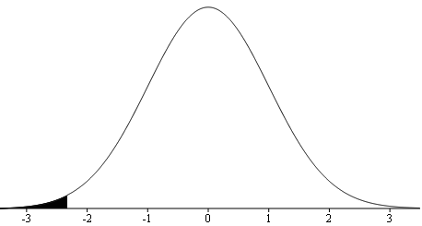

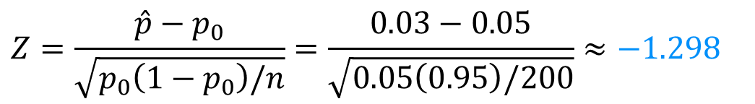
1. α = 0.01
2. H₀: p = 0.05 Vs H₁: p < 0.05
3. Test Statistic:
$$Z=\frac{\hat{p}−p_{0}}{\sqrt{p_{0}\left(1−p_{0}\right)/n}}=\frac{0.03−0.05}{\sqrt{0.05\left(0.95\right)/200}}≈−1.298$$
4.
Rejection Region:
$$Z≤−z_{1−α}=−z_{0.99}=−2.33$$
Rejection Region
5. z = -1.298 is NOT in the rejection region, H₀ is NOT rejected
6. At 1% level of significance the proportion of people agreeing to new tax reform is 5%
7.
P-value = $P\left(Z≤−1.298\right)=normalcdf\left(−99,−1.298\right)=0.0971$
Notes:
The p-value is NOT less than α = 0.01, therefore, H0 is not rejected at 1% significance level, which is the same conclusion made using the testing process

Slide 8
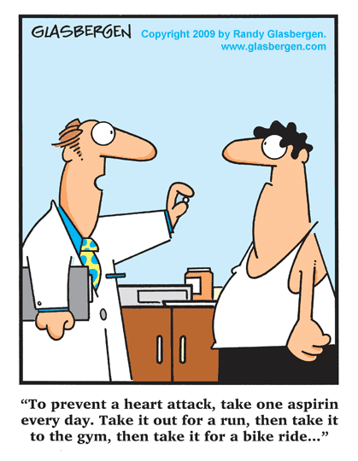
Practice Problems Part 4
1. In a recent study of 22,000 male physicians, half were given regular doses of aspirin while the other half were given placebos. The study ran for six years at a cost of $4.4 million. Among those who took the aspirin, 104 suffered heart attacks. Among those who took the placebos, 189 suffered heart attacks*.
This is a classic experiment involving a treatment and a placebo group. Test if the results show a statistically significant lower rate of heart attacks among the sample group who took aspirin.
Research shows that it works, just saying.
* Time and the New England Journal of Medicine, Vol. 318, No. 4
Notes:
Answers are in Ch7 Practice Problem Solutions

Slide 9

Practice Problems Part 4
2. In a random sample of 1500 infant deaths, it was found that 300 deaths were directly related to a birth defect.
Determine the point estimate for infant mortality due to birth defect. At the 5% level of significance, perform an appropriate one-tail hypothesis testing the claim that the true proportion of infant mortality due to birth defects is 25%.
The mortality rate of infants has decreased steadily as access to doctors and better health monitoring systems increased.
Notes:
Answers are in Ch7 Practice Problem Solutions

Slide 10

Practice Problems Part 4
3. The University of Manitoba research station wishes to investigate if a new variety of wheat is more resistant to a disease than an old variety.
It is known that this disease strikes approximately 15% of all plants of the old variety. A field experiment was conducted, and out of 120 new plants, 12 became infected. Compute test statistic and p-value and make a conclusion.
Use your calculator efficiently
Notes:
Answers are in Ch7 Practice Problem Solutions

